Slide 1
Simulator of Northeast Offshore Wind Buildout and LCOE (SNOWBaL)
Use Case: Evaluating the Value Proposition of a New Point of Interconnection (Demo)

Slide 2
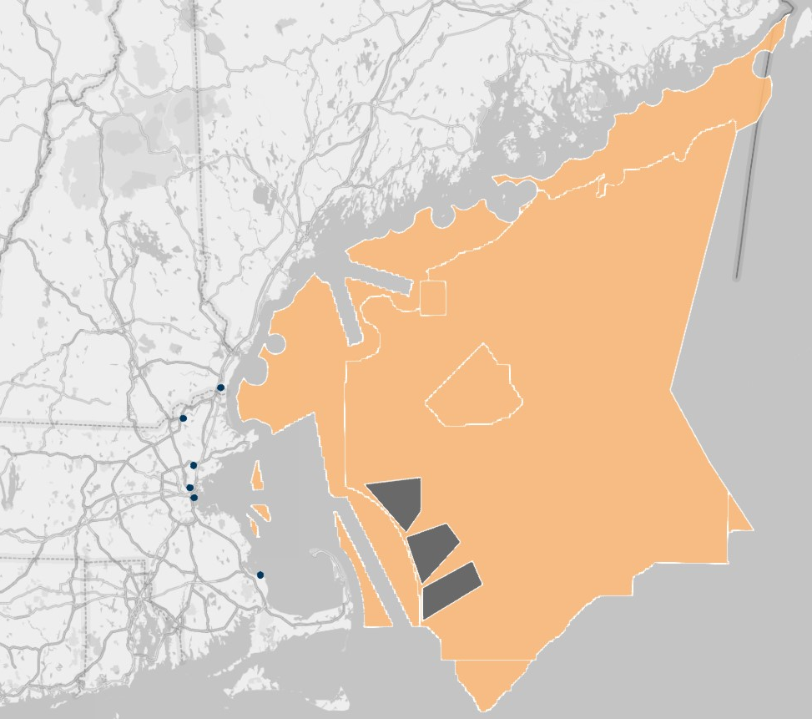
Use Case (Demo):
Evaluating the Value Proposition of a New Point of Interconnection
Evaluating the value proposition for a new plug-in point for interconnecting Gulf of Maine lease areas
Approach: Compare programmatic cost to NE states (CT/MA/RI) for procuring combined 6 GW offshore wind from Gulf of Maine in 2030-2034 under 2 scenarios:
  Business-As-Usual: Projects are interconnected to available POIs; full T&I costs, including illustrative system upgrade costs, are borne by developers and recovered through bundled PPAs
  New Socialized POI: Projects are interconnected to a single new POI; costs of new substation and system upgrades are allocated to customers under FERC-approved agreement and not borne by developers (i.e., NJ SAA model)
Key metrics:
  Weighted average bundled PPA contract price ($/MWh)
  Weighted average REC premium ($/MWh)
  Gross REC payment (2030 $ NPV)
Other variables:
  Procurement trajectory
  POI system upgrade cost
Seabrook
Ward Hill
New POI
Mystic
3 Hypothetical Gulf of Maine lease areas based on BOEM RFI company nominations
~1,700 km2; ~8,000 MW @ 16-MW turbine
1
K Street
2
3
Pilgrim

Slide 3
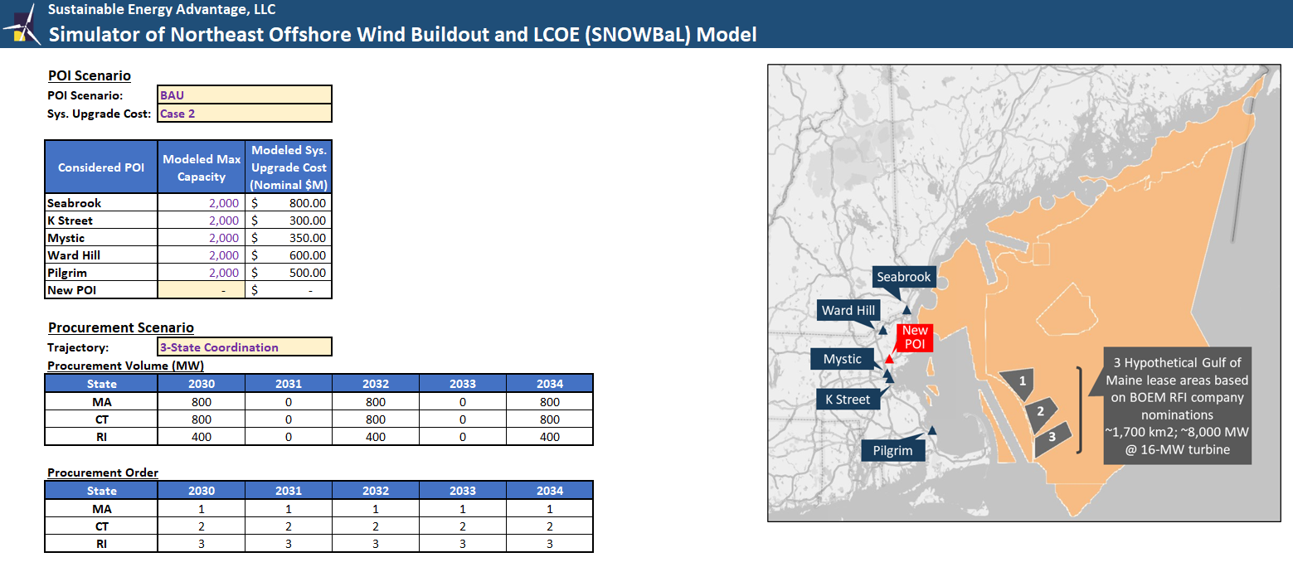
Use Case (Demo)
Business-As-Usual Case Set Up
Assumes projects are interconnected to available POIs; full T&I costs, including illustrative system upgrade costs, are borne by developers and recovered through bundled PPAs

Slide 4
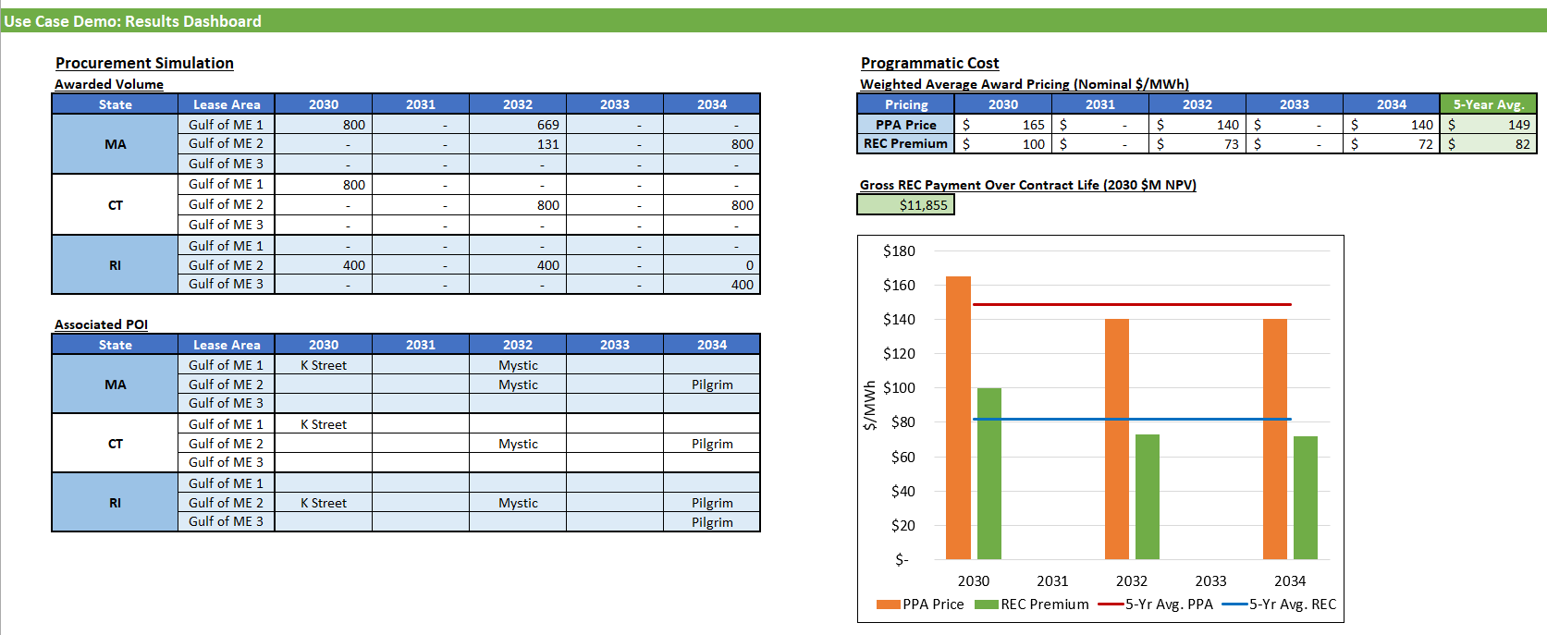
Use Case (Demo)
Business-As-Usual Case Results

Slide 5
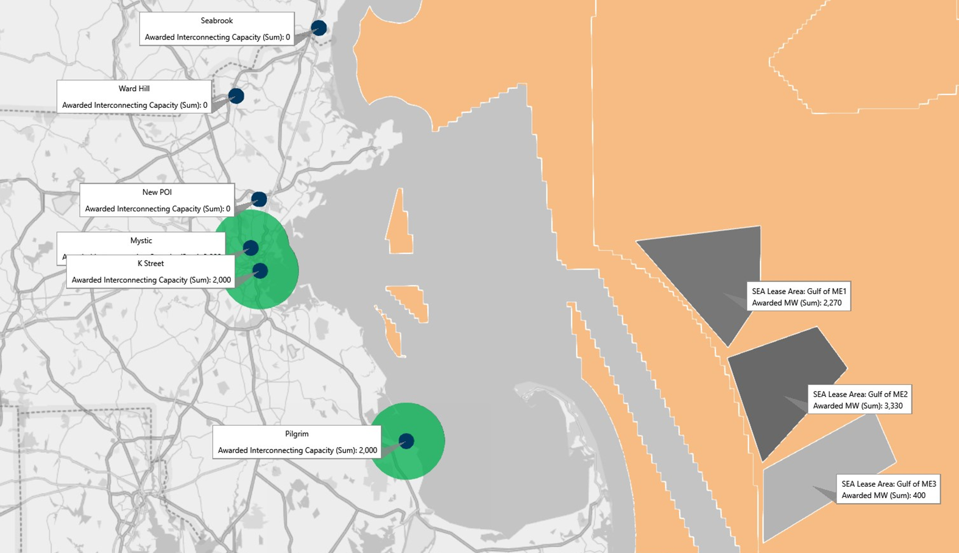
Use Case (Demo) Results
Business-As-Usual Case Results
Map Results Showing Deployment Buildout and Chosen POIs for Awarded Projects

Slide 6
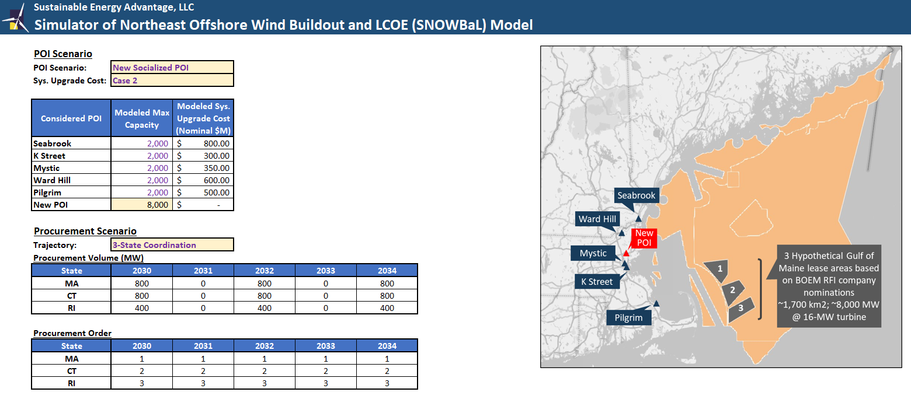
Use Case (Demo)
New Socialized POI Case Set Up
Assumes projects are interconnected to available POIs; full T&I costs, including illustrative system upgrade costs, are borne by developers and recovered through bundled PPAs

Slide 7
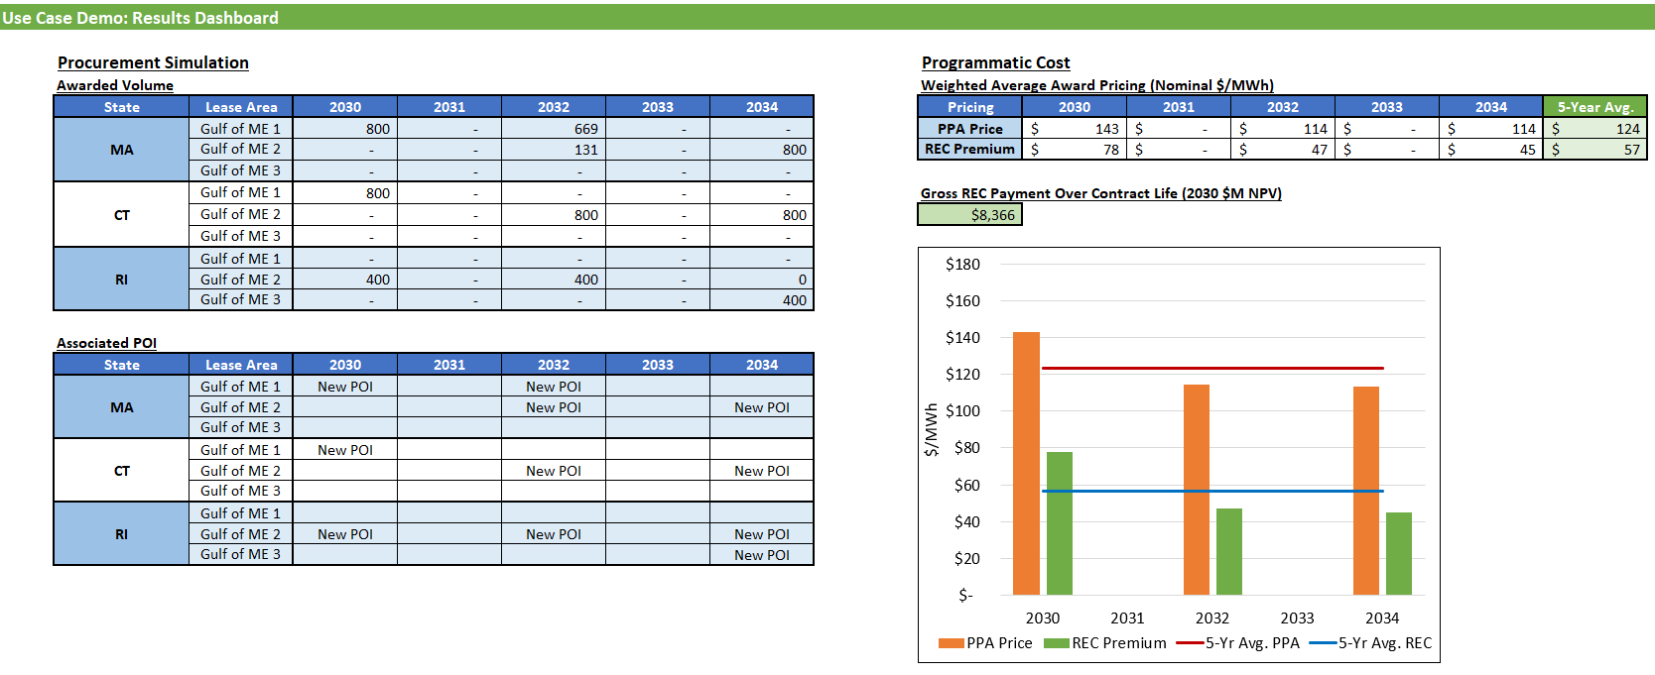
Use Case (Demo) Results
New Socialized POI Case Results
Assumes projects are interconnected to available POIs; full T&I costs, including illustrative system upgrade costs, are borne by developers and recovered through bundled PPAs

Slide 8
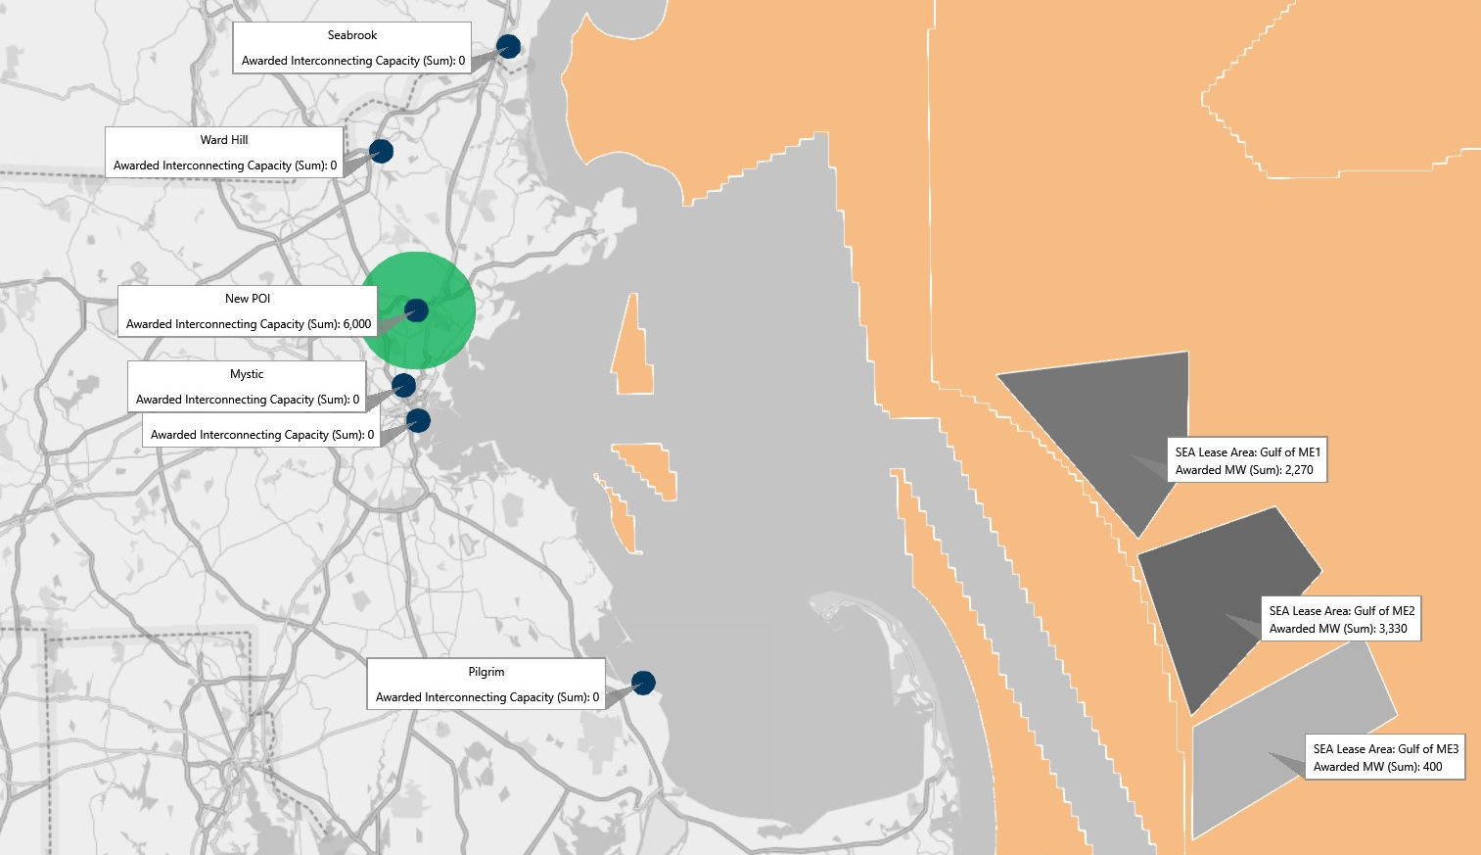
Use Case (Demo) Results
New Socialized POI Results
Map Results Showing Deployment Buildout and Chosen POIs for Awarded Projects

Slide 9
Contacts:
Bob Grace
508-665-5855
bgrace@seadvantage.com
Po-Yu Yuen
508-665-5861
pyuen@seadvantage.com

