Slide 1
Simulator of Northeast Offshore Wind Buildout and LCOE (SNOWBaL)
Use Case: Benchmarking Offshore Wind Offtake Pricing

Slide 2
Use Case:
Benchmarking Offshore Wind Offtake Pricing
Benchmarking offshore wind offtake prices to support an offtaker (offtaker X) in establishing and bounding pricing expectations for competitively-derived PPAs and bilaterally-negotiated PPAs
Approach: Model expected benchmark offshore wind bundled PPA price level and evolution over time under alternative scenarios of:
  State competitive procurement trajectories; and
  Bidder outlook on ability to leverage continuous deployment economy of scale (developing subsequent projects / expansions within the same lease area)
Key metrics:
  Weighted average award contract price ($/MWh)
  Marginal award contract price ($/MWh)
  Weighted average award LCOE ($/MWh)
  Marginal award LCOE ($/MWh)
  Award projects and volume
Other variables:
  Local content and economic development cost adders
  Bidders’ assumed lease costs in bid pricing (actual vs ‘marked-to-market price)

Slide 3
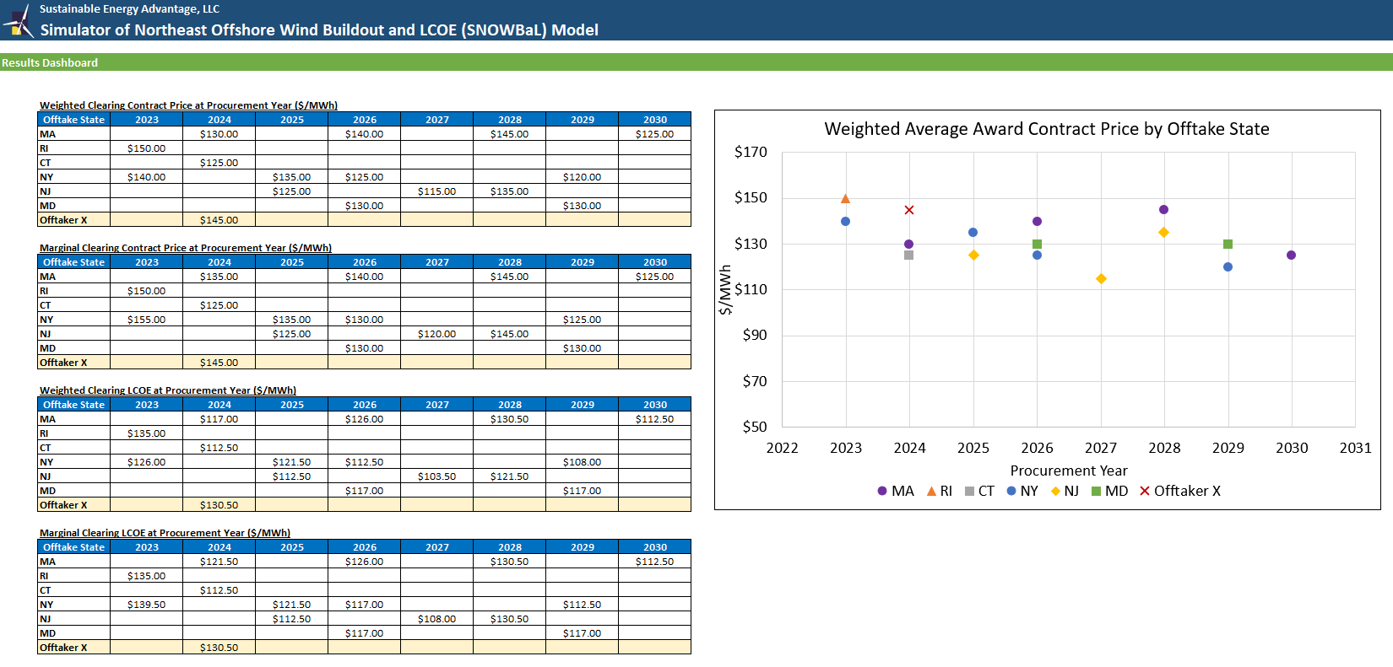
Use Case Results (Illustrative Numbers)
SNOWBaL Results Dashboard: Pricing
Evaluate award outcomes over time
Assess interstate competition dynamics
Visibility into competitive offtake outcomes overtime to inform offtaker on optimization of procurement volume and timing to enhance market appeals to bidders and leverage regional deployment economy of scale

Slide 4
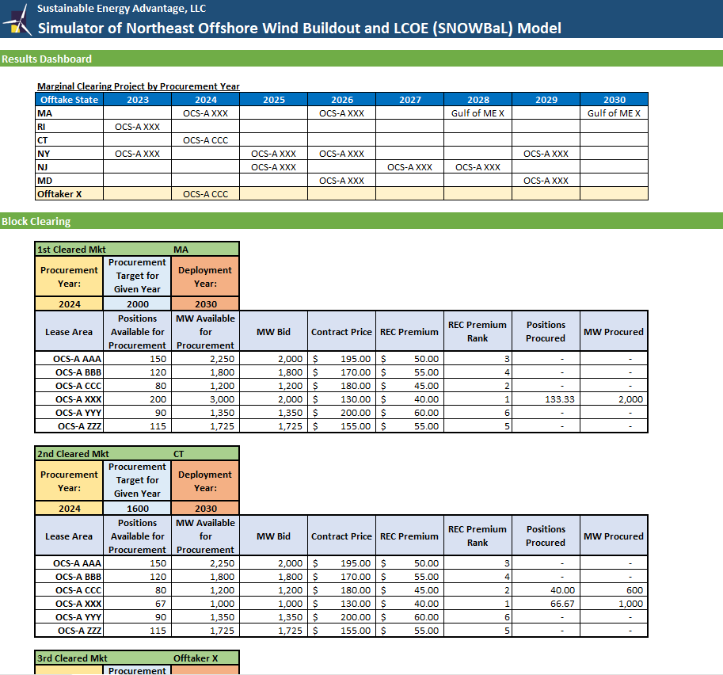
Use Case Results (Illustrative Numbers)
SNOWBaL Results Dashboard: Award Projects
Detailed resolution into which project(s) selected for contract award under each sequential procurement event, and at what price?
  Evaluate interstate competition dynamics
  Inform procurement scheduling to navigate interstate competition, while leveraging regional coordination to attract more competitive bids and leverage economy of scale
  Provide visibility into offshore wind buildout ➔ When and where are pressure points to avoid?
  Test need and implications of new lease areas in later years

Slide 5
Contacts:
Bob Grace
508-665-5855
bgrace@seadvantage.com
Po-Yu Yuen
508-665-5861
pyuen@seadvantage.com

